Slide 1
Doing more with less: how to make good text classifiers without a lot of data
Toby Sachs-Quintana

Slide 2

Application: keeping track of trending issues
Low data situation
The number of documents for a set of issues is small
10 - 100 training examples, not 1000s
It can be hard to find trending issues

Slide 3

Detecting trending issues is important for customer service
Stopping problems before they become really big problems
Helps the product development cycle
If only Ironman could’ve spot this trending issue earlier!

Slide 4

Machine learning and automation to the rescue!

Slide 5

Steps to fix the problem of detecting trending issues
Tools to test for over-fitting
Simple models
Multi-dimensional word vectors
Neural nets
Bonus topics

Slide 6
Models trained on 95 data points
Model | Train time | Test Score
CNN with 2D word embedding | 1.5h on a CPU | 0.70
Two layer neural net | 1.5h on a CPU | 0.70
SVM | < 1sec | 0.71+/- 0.05
Naïve Bayes | < 1sec | 0.63 +/- 0.14

Slide 7
20 newsgroups public dataset
Training data
1800 newsgroups posts on 20 topics
Rec.motorcycles vs. rec.autos
Filter headers, footers, and quotes
Tokenize and lemmetize ‘autos’ = ‘auto’
Newsgroups | Number of posts
Autos | 594
Motorcycles | 598
Test data
Newsgroups | Number of posts
Autos | 396
Motorcycles | 398

Slide 8
Cross-validation curves are a great tool to measure over-fitting.
Test
Train
Error
Model complexity
number of features

Slide 9
Cross-validation curves are a great tool to measure over-fitting.
Test
Train
Error
Score
Model complexity
number of features
Model complexity
number of features

Slide 10
Learning curves are a great tool to measure bias.
Test
Train
Score
Number of training examples

Slide 11
Learning curves are a great tool to measure over fitting.
Test
Over fit
Under fit
Train
Score
Number of training examples

Slide 12
Learning curves are a great tool to measure bias.
Test
Train
How to fix over fitting
Less features
More data
More regularization
How to fix under fitting
More features
Less regularization
Over fit
Under fit
Score
Number of training examples

Slide 13
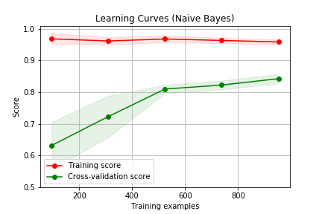
Naïve Bayes
Probability of document being a class is joint probability of the words indicating the class
Accuracy = 83%
95 training examples 63% +/-14%
TF-IDF representation of words
The area we care about

Slide 14
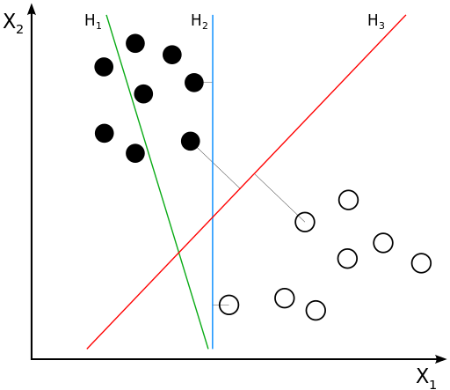
Support Vector Machines
Maximize separation
Non linear separation is fast
Regularization penalty for more features

Slide 15

Support Vector Machines
H2
H1
Maximize separation
Non linear separation is fast
Regularization penalty for more features

Slide 16
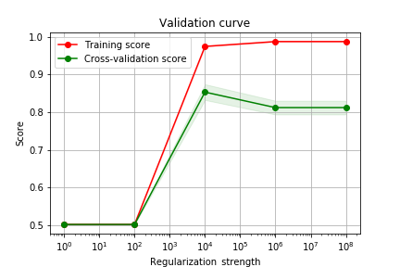
Support Vector Machines
Regularization coefficient of 1e6 determined by regularization curve
Rbf kernel

Slide 17
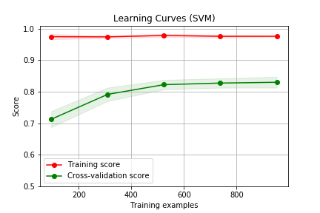
SVM learns faster than naïve bayes

Slide 18
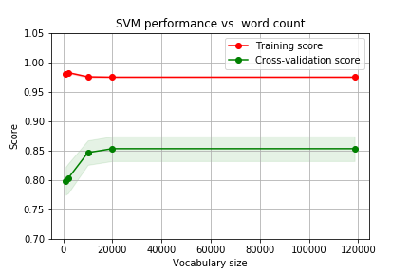
Vocabulary needed for SVM
Increasing the regularization strength allows for more features (words)
TF-IDF representation of words

Slide 19
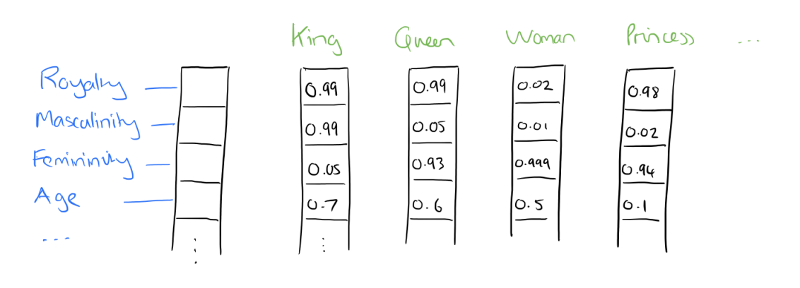
TF-IDF Word Vectors
Number of times the word is in the post (TF) | 5
Number of times in all posts (DF) | 100
TF/DF | 0.05
Adrian Colyer
https://blog.acolyer.org/2016/04/21/the-amazing-power-of-word-vectors/

Slide 20
TF-IDF Word Vectors
Number of times the word is in the post (TF) | 5
Number of times in all posts (DF) | 100
TF/DF | 0.05
Adrian Colyer
https://blog.acolyer.org/2016/04/21/the-amazing-power-of-word-vectors/

Slide 21
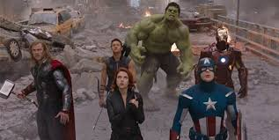
Word vectors
Predict center hero
based on context heroes
Previously words were represented as a single number
Now a word is represented as a vector.
Predict surrounding words based on center words
Use gensim word2vec

Slide 22
Word vectors
Previously words were represented as a single number
Now a word is represented as a vector.
Predict surrounding words based on center words
Use gensim word2vec

Slide 23
Check the vector similarity
model_100.wv.doesnt_match(['wheel', 'car', 'wave'])
Helpful for debugging before applying a model
Word Dimensionality | Corpus used for training | Word that does not belong
2 | Twenty newsgroups | car
100 | Twenty newsgroups | wave
300 | Google newsgroup | wave

Slide 24
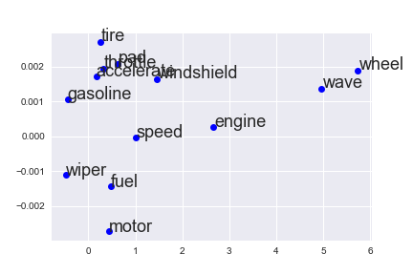
Averaging word vectors in a document

Slide 25
Documents can be built by averaging the vectors or stacking them
Example phrase “engine fuel”
 | X1 | X2
engine | 2.8 | 0.0002
fuel | 0.2 | -0.0013
Y
X Engine fuel
X

Slide 26
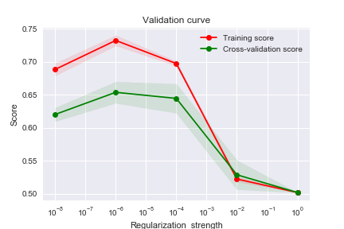
Performance of SVM averaging word vectors
Notes:
Documents sometimes have a narrative that is very specific

Slide 27
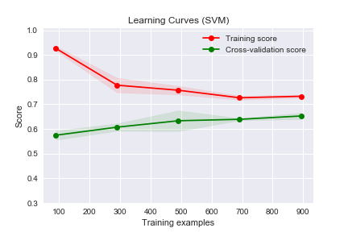
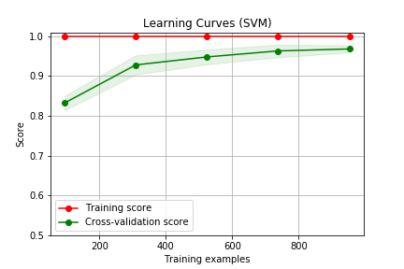
TF-IDF performs better than word embeddings
SVM using average word embeddings
SVM using TF-IDF vectorization

Slide 28
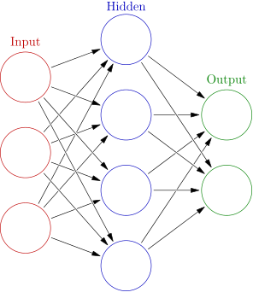
Simple neural network
300 hidden units
Input word vector length = 300
2 outputs
Notes:
By Glosser.ca - Own work, Derivative of File:Artificial neural network.svg, CC BY-SA 3.0, https://commons.wikimedia.org/w/index.php?curid=24913461

Slide 29
Simple neural network
Newsgroups | Number of posts
Autos | 594
Motorcycles | 598
300 hidden units
300 input units
 | Features
Input to hidden | ~90K
Hidden to output | ~600
2 outputs
Notes:
By Glosser.ca - Own work, Derivative of File:Artificial neural network.svg, CC BY-SA 3.0, https://commons.wikimedia.org/w/index.php?curid=24913461

Slide 30
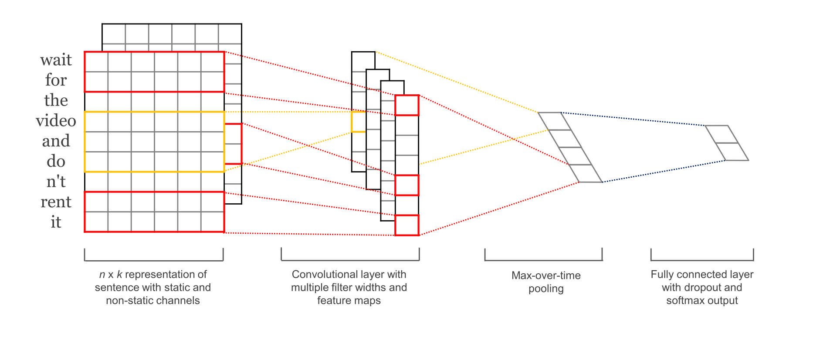
Convolutional Neural Networks
Documents are transformed to two dimensional arrays.
Apply the same algorithm that is used for images

Slide 31
Convolutional Neural Networks trained on the full data set
Model | Train time | Test Score
CNN with 2D word embedding | 1.5h on a CPU | 0.79
Two layer neural net | 1.5h on a CPU | 0.65
SVM | < 1sec | 0.83 +/- 0.03
Naïve Bayes | < 1sec | 0.84 +/- 0.03

Slide 32
Convolutional Neural Networks trained on 95 data points
Model | Train time | Test Score
CNN with 2D word embedding | 1.5h on a CPU | 0.70
Two layer neural net | 1.5h on a CPU | 0.70
SVM | < 1sec | 0.71+/- 0.05
Naïve Bayes | < 1sec | 0.63 +/- 0.14

Slide 33

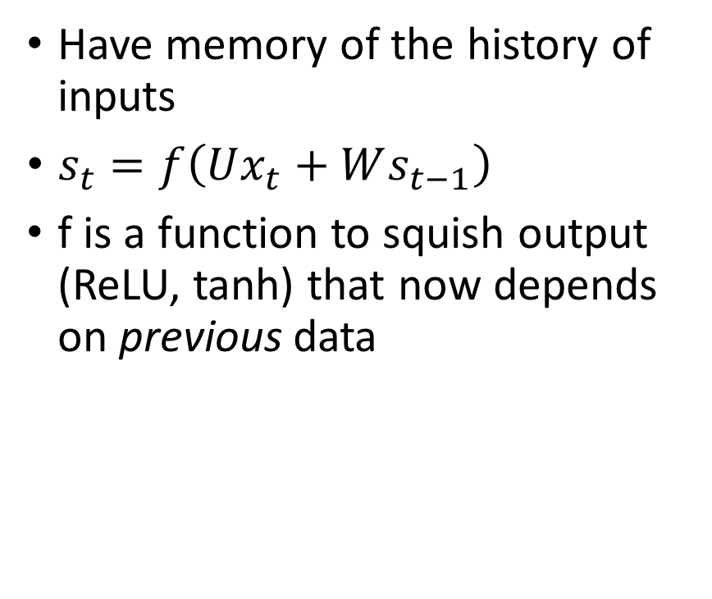
Recurrent Neural Networks
Have memory of the history of inputs
$s_{t}=f\left(Ux_{t}+Ws_{t−1}\right)$
f is a function to squish output (ReLU, tanh) that now depends on previous data

Slide 34
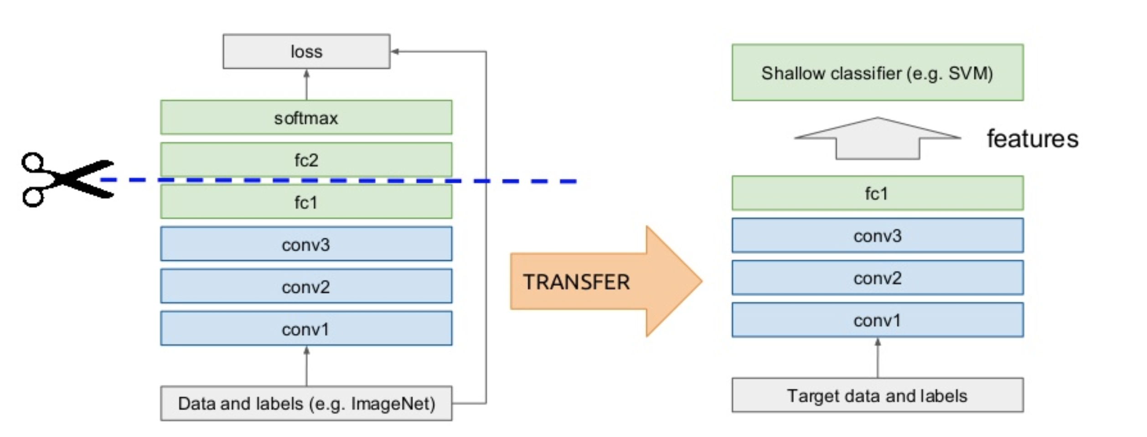
Transfer learning
Train one model on a larger dataset to get the initial weights.
Save the weights
Feed in the new data and adjust the weights
Good for images, limited success for documents
Kevin McGuinness, UPC 2016

Slide 35
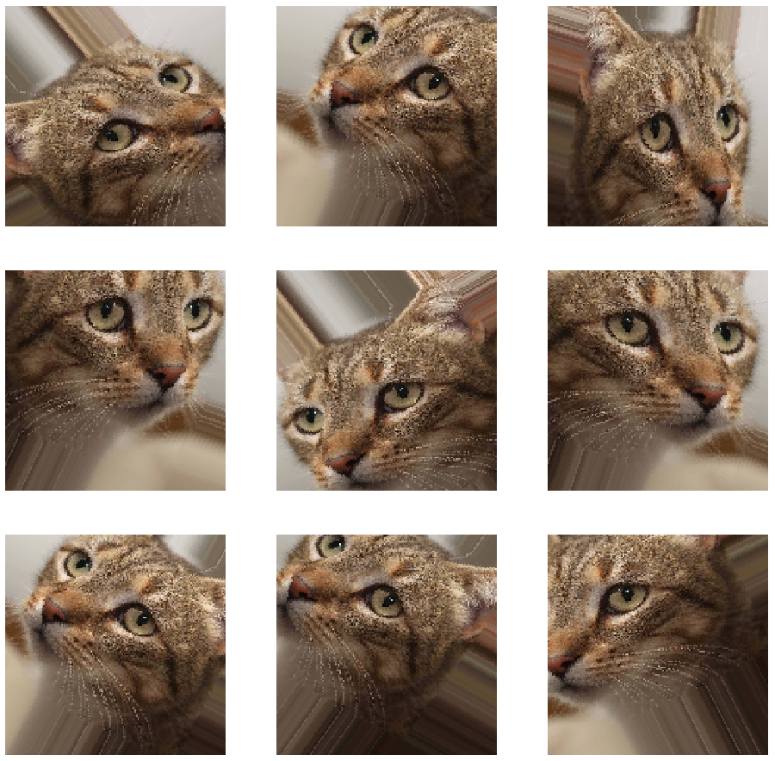
Building more data for images
Arden Dertat “Applied Deep Learning”

Slide 36
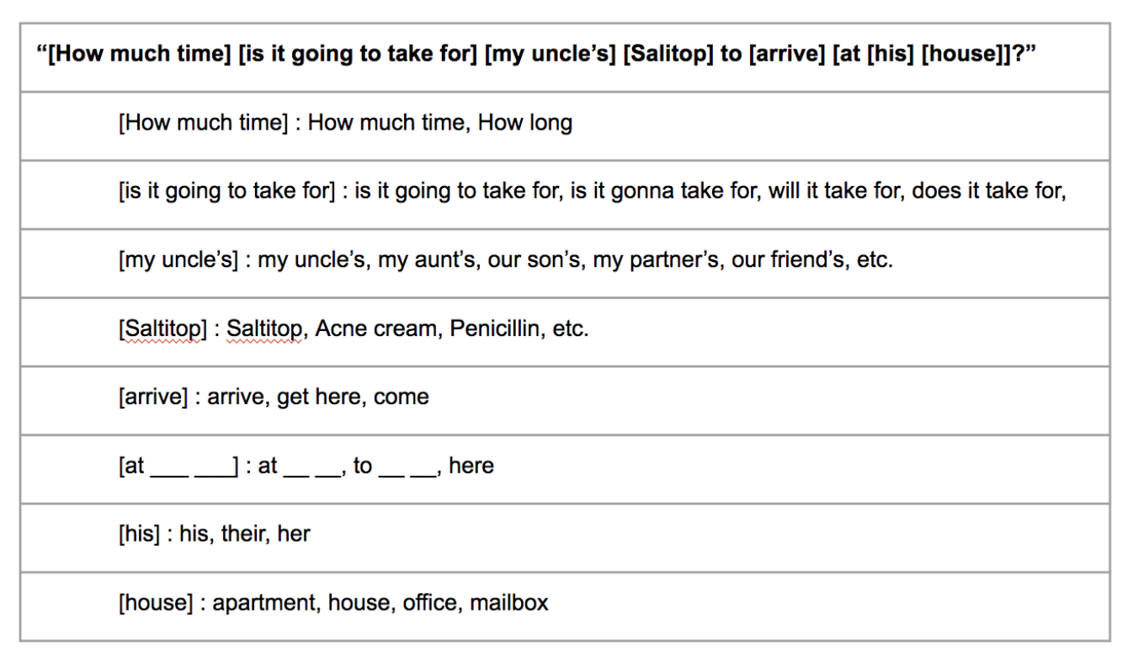
Building more data through finite state grammar

Slide 37

How to get good results with not a lot of data
Simple models (SVM)
Transfer learning if a larger store of similar documents
Finite state grammar if the text has similar structure
Waiting for deep learning model to train

Slide 38
Questions?
Simple models (SVM)
Transfer learning if a larger store of similar documents
Finite state grammar if the text has similar structure
Toby Sachs-Quintana
tobys@alumni.stanford.edu
Waiting for deep learning model to train

